Slide 1
Stephanie Cherrett Visit South Devon

Slide 2
Using the Exe Estuary Trail to help tourism thrive

Slide 3
August 2012 Visit South Devon Visitor Survey
When asked how they researched and planned their holiday 82.9% used the internet, 38.9% used free area guides, recommendations from friends scored 21.3%
and paid for guide books only scored 5%
Which of the following appealed to you about South Devon when deciding to book your holiday here?
What type of accommodation did you stay in?
71.9% stated that their holiday to South Devon was not their only holiday of the year
How far in advance of your holiday did you book it?
80.5% travelled by car to get to South Devon and 76.2% travelled around by car once here.
35.2% used public transport once here
72.6% didn’t leave South Devon during their break
48.6% stated that they stayed for between 4 and 7 days.
With a further 34.9% staying for 1-4 days.
Notes:
To start with I thought you would be interested in some recent research we have undertaken with visitors to South Devon. We wanted to find out why people come to the region and what they do once they are here – which I think is particularly relevant when looking at the Exe Estuary Trail and the benefits to tourism that it will bring.
Businesses in Dawlish and the surrounding area will of course be interested in how they can benefit from the visitors the trail will bring. By looking at what draws people here you can see that the landscape and wildlife score very highly and Food and Drink is a big driver as well.
You can also see the types of accommodation that people are using when they visit – with Self-Catering being the most popular and Caravan Parks and Hotels coming in close.
Whilst sports and activities scores less well in regards to what appealed to them about the area when booking their holiday a look at what people are looking at on the VSD website in relation to activities shows the types of things people are interested in in the area.

Slide 4
www.visitsouthdevon.co.uk
 | Page Views
Home | 75,062
Lots to Do | 33,318
Festivals and Events | 25,752
Dogs on Beaches | 21,263
Events Calendar | 18,302
Where to Stay | 16,783
South Devon Map | 13,043
Explore South Devon | 11,915
Information and Map | 10,336
Special Breaks | 10,329
Notes:
After the home page we see lots of interest in people looking for things to do and festival and events.
Another interesting point – which I will come back to later – is people searching for maps of South Devon.

Slide 5
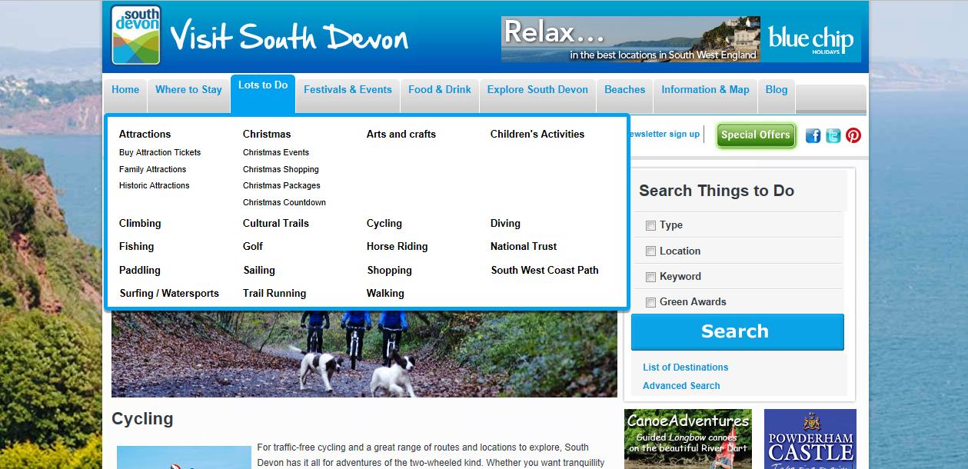
 | Page Views
Lots to Do – Cycling | 2,701
Lots to Do - Walking | 2,070
Lots to Do – Surfing/Watersports | 1,700
Lots to Do – Sailing | 451
Lots to Do – Shopping | 116
Notes:
When looking more specifically at the activities that people are interested in on our site cycling comes out top by quite a bit – with walking as the second most popular.
This shows there is a real interest in these past times and people are looking for information about them when planning a visit here.

Slide 6
When asked how they researched and planned their holiday 82.9% used the internet, 38.9% used free area guides, recommendations from friends scored 21.3% and paid for guide books only scored 5%
Notes:
I now wanted to talk about some interesting ways businesses have worked to benefit from having something like the Exe Estuary Trail ending within their locality. How they have embraced the opportunity to gain from it’s popularity.
Our research shows us – as can be expected – that the internet is the key resource for people when planning a visit.
There are various things that tourism business within Dawlish and the surround could be doing to attract this traffic – and here are just some examples....

Slide 7
Notes:
This shows a results page for a simple Google search for ‘The Camel Trail’ in Cornwall. Of course the first few listings show information on the trail however, what is interesting to note is two listings I have highlighted. These are businesses that are nothing to do with the Camel Trail in regards to information about it but are located close by.
By clever use of wording in their copy they have ensured that they are showing when people are looking for information on the trail – people that are likely to be considering hiring a bike or maybe enjoying some wine once they’ve reached their destination! We already know that food and drink is a big consideration for people visiting an area.

Slide 8
Notes:
Another example is this one – these results are from searching ‘padstow cycle trail’– here we see a business that has incorporated the name of the trail into their web address.

Slide 9
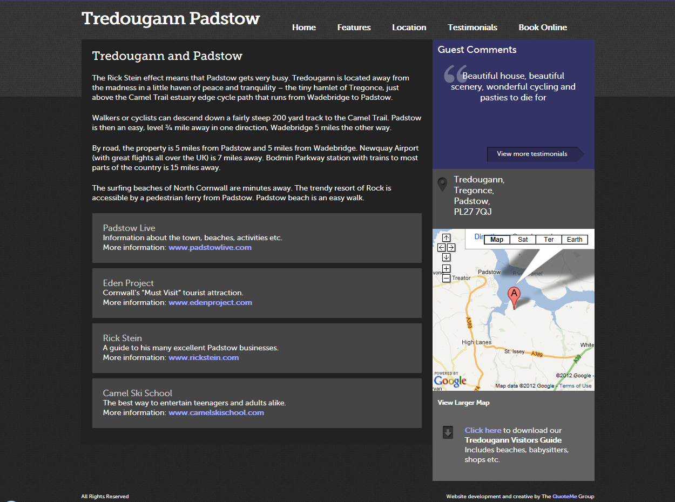
Notes:
When you click through on the link you’ll see that in fact the cottage is called something else entirely. By using the web address and incorporating the camel trail into their web content they are ensuring that people find their business when people are planning a visit to the trail.

Slide 10
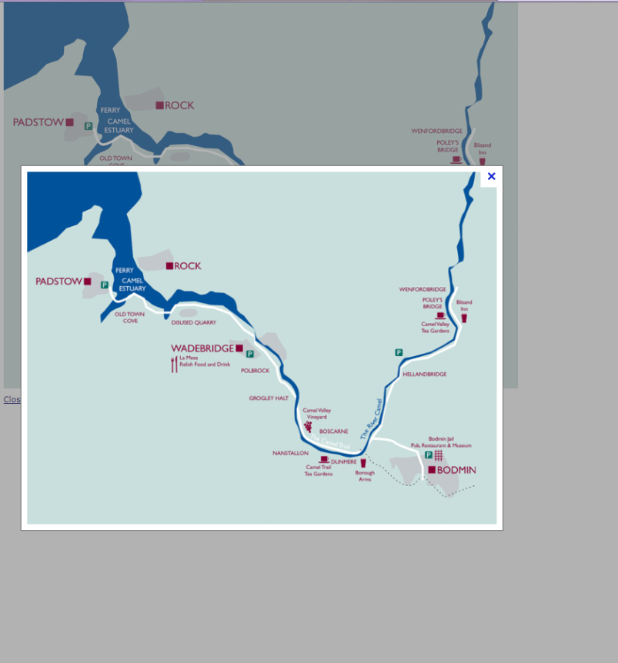
trailbikehire.co.uk
Notes:
Here’s another interesting idea – I mentioned earlier about how searching for a map of South Devon is one of the biggest drivers to our site. We see that people then stay on our site, once they’ve found the map, to look at other information.
When you look at the images once you have searched for the Camel Trail in Google one of the best maps is shown here – clicking through to the site to get a copy of the map shows us that this is actually on a bike hire website. Again – driving interested people to their site.
So business within Dawlish should be thinking along these lines in regards to benefitting from online search for the Exe Estuary trail. How can you be a part of the landscape online when people are researching the trail?

Slide 11
Notes:
Another key element to consider is interaction online – not just information giving. Visit South Devon has over 8,000 followers through social media – we monitor conversations online and interact daily – this increases awareness of us and drives traffic to our site.
Taking a look at twitter and again considering The Camel Trail – we can see that people have cottoned onto this and used it to their advantage. This company here have named their handle @TheCamelTrail – this means they instantly appear when anyone searches for information on Twitter in regards to the trail – promoting their business.

Slide 12
Notes:
What’s even more effective however is to monitor if people are talking about the trail online. For example – this person here says Finally clean and dry after falling off my bike on the Camel Trail – ‘Now to the pub and log fire!’
If you were owned a pub with a log fire in Dawlish here is a great opportunity to re-tweet this message suggesting they come and enjoy a pint in front of you log fire. This message then not only goes to that individual but is seem by anyone looking on twitter for information about the trail.
A tweet here refers to everyone meeting at the car park for the Camel Trail – if you own the refreshment stall in that carpark – what better opportunity to invite them to visit?!
On somewhere like Twitter you have an engaged, active audience looking to talk – making sure you’re part of the conversation can only help drive business to you.

Slide 13
Lots to Do | 33,318
Festivals and Events | 25,752
Dogs on Beaches | 21,263
Events Calendar | 18,302
Notes:
The second area I wanted to talk about was events. Whilst our research shows that people do not come to a region because of the events, our website shows that when people are coming they are interested to see what is on and take part in events and festivals whilst they are here. And it is these events that determine where they visit.
By being a destination on the trail Dawlish will become associated with cycling – and I’m sure you have discussed this already – but embracing this and developing events around this can only help drive visitors, and ultimately income, to the area.

Slide 14
Notes:
Here’s just an example of a cycling festival already in existence. Abergavenny have created a whole weekend of events around cycling with races, a family festival and parades. They include a where to stay section which is driving business to accommodation providers in the area and other businesses can get involved with the various events taking place. Events such as this help to make an area a destination.

Slide 15
Notes:
By working together to build yourselves into a cycling destination this would raise your profile. Visit South Devon has sections of the site dedicated to cycling and we would feature you of course.
Working together is key – thinking about what people are going to be looking for after a long day of cycling....

Slide 16
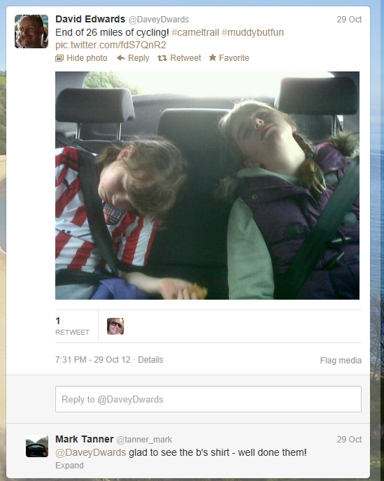
Notes:
It might be a bed for the night!

Slide 17
Notes:
Or somewhere to refresh and enjoy the view......
What can your business offer this audience? It may not be obvious....but be creative!

Slide 18
Notes:
The local chemist doesn’t need to miss out for example!

Slide 19
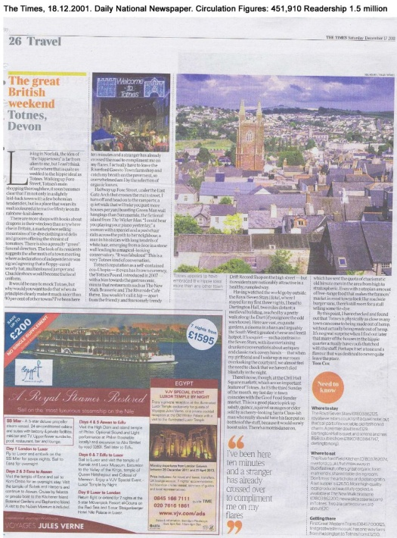
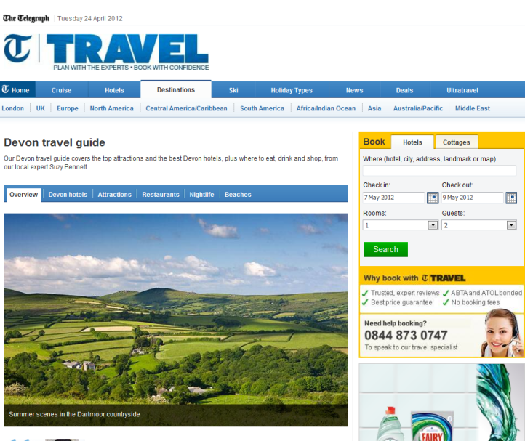
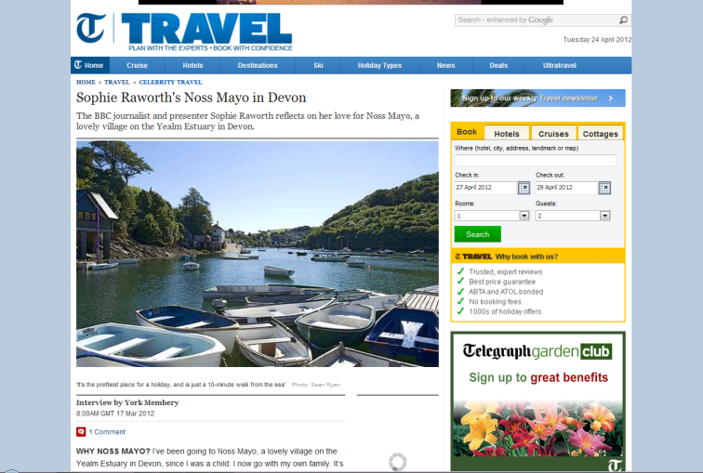
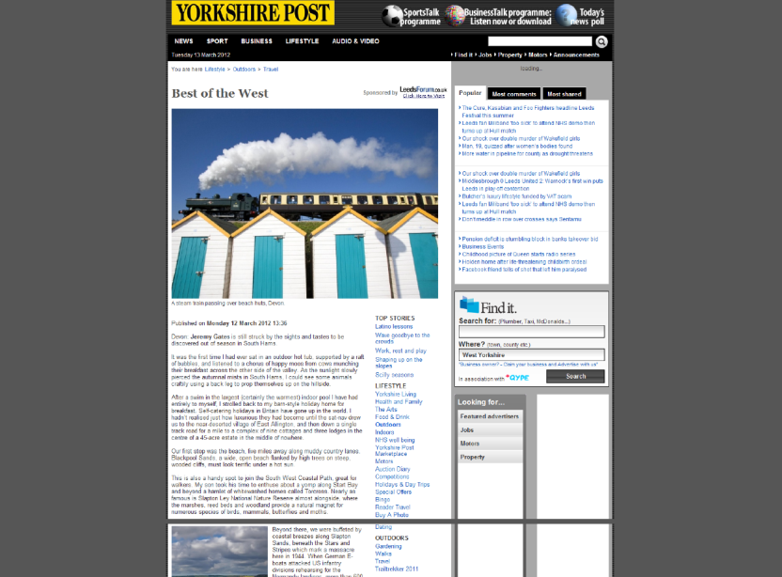
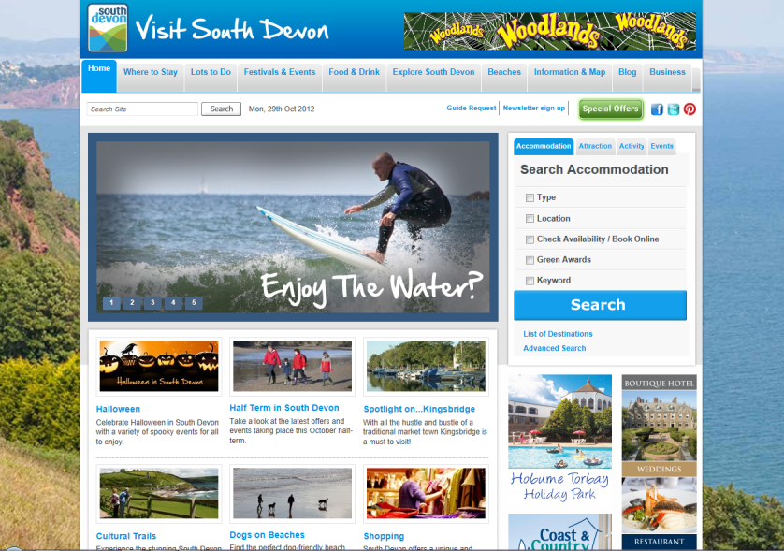
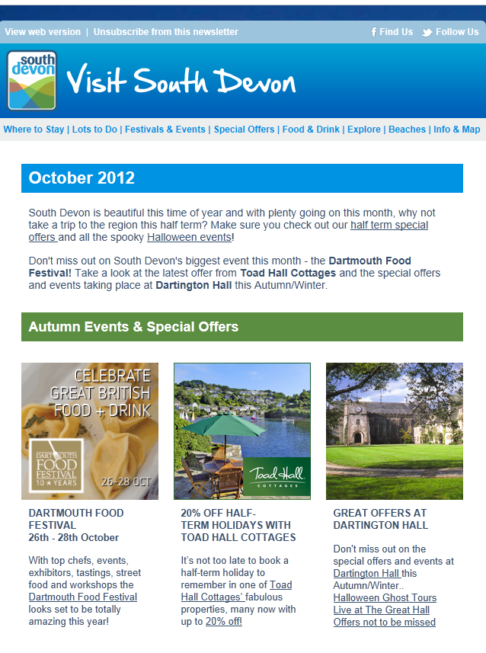
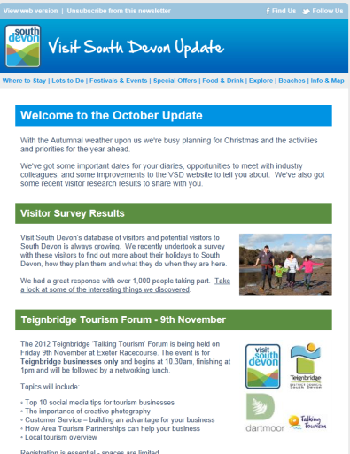
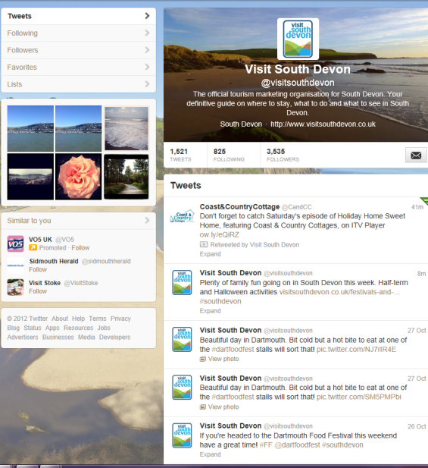
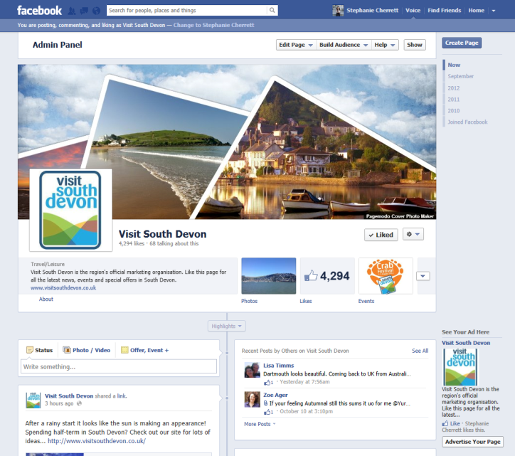
Working with VSD
Always looking for events that will bring people to the region to get involved in and promote
320,000 visits to our website each year – dedicate a section to the Exe Estuary
22,000 visitors on our database – interested in stories, promotions and events
Notes:
So this is all very well but how can Visit South Devon help – other than my thoughts today....
Well – we’re always looking for events to support and get involved in. We focus on achieving national coverage for the region so make sure you talk to us about your plans and maybe we can get involved and help you get the message out there.
Our website has over 320,000 visits a year and we’d be happy to build a section that focuses on the Exe Estuary and the section within South Devon. And we communicate regularly with over 22,000 people interested in the area and what is going on.
We’d like to support you where we can so make sure you let us know what’s going on.

Slide 20
Thank you for listening Visit South Devon

